Slide 1
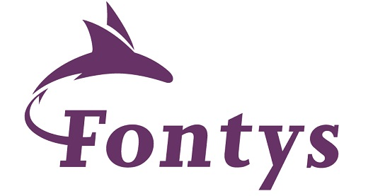

Microservices in real life – with Node & Dapr.io March 2022
Lucas Jellema Architect & CTO AMIS | Conclusion
labs: https://github.com/lucasjellema/fontys-2022-microservices-kafka-dapr
Notes:
Wat is een microservice? (waarom, problemen met monolitische applicaties, hoe microservice architectuur, generieke voorzieningen & platform voor microservices, data & events als glue tussen microservices)
Hier alvast stilstaan bij het belang van een event broker en een korte intro van Kafka (meer in college 2)
Implementatie van microservices: afhandelen van http requests, consumeren en publiceren van events, doen van http calls: wat zijn activiteiten die iedere microservice moet uitvoeren? (state mgt, pub/sub, secrets, config mgt, aanroepen 3rd party (cloud) services, ..)
Introductie en demo van Dapr.io framework – de personal assistant die iedere applicatie eenvoudig laat aansluiten op generieke voorzieningen én die applicaties (microservices) met elkaar laat interacteren op ontkoppelde wijze; note: ik zal wijzen op de ondersteuning in Dapr.io voor diverse technologieën zoals RabbitMQ, MySQL, Redis
Handson met Dapr – meegeleverde applicaties in Java en C#
Zelf implementeren van microservice – introductie van NodeJS ;
Handson: afbouwen eenvoudige services in NodeJs en via Dapr.io interactie met elkaar en met generieke voorzieningen

Slide 2




80 colleagues, located in Nieuwegein
Founded in 1991 by students from University of Twente – Aircraft Maintenance Information System (AMIS)
the core of what we do: working with Data.
partnering with peers and companies in several countries
Lucas Jellema (2002)
Cloud Solution Architect & CTO
lucas.jellema@amis.nl | technology.amis.nl | @lucasjellema | lucas-jellema

Slide 3
Data & Application Integration
cloud, DevOps, PaaS, streaming, microservices, Software Studio, database, software engineering
web applications
Data Engineering, Data Analytics (& Data Science)
Oracle, Microsoft Azure, open source, Java, SQL, NodeJS, Python, React/Angular
Internet of Things

Slide 4







Slide 5






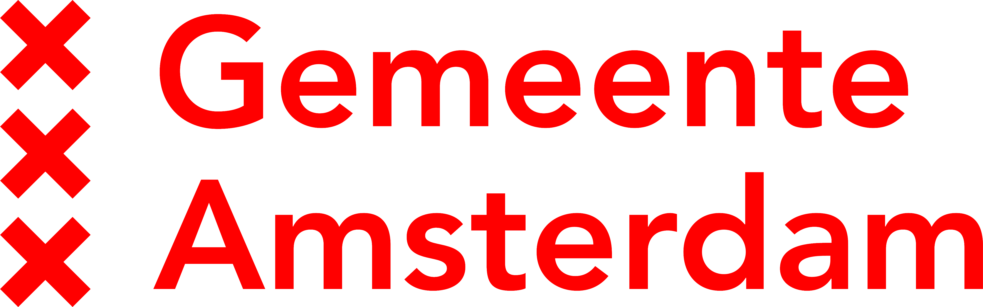


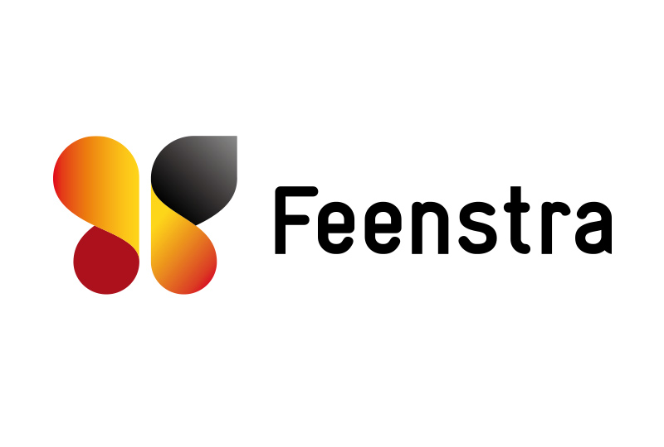

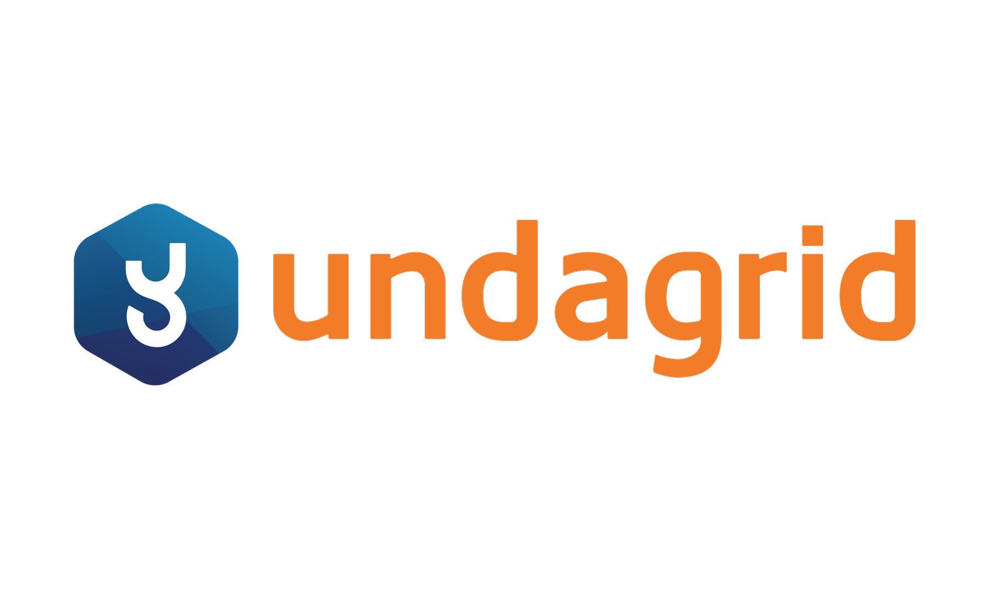









Slide 6












Slide 7
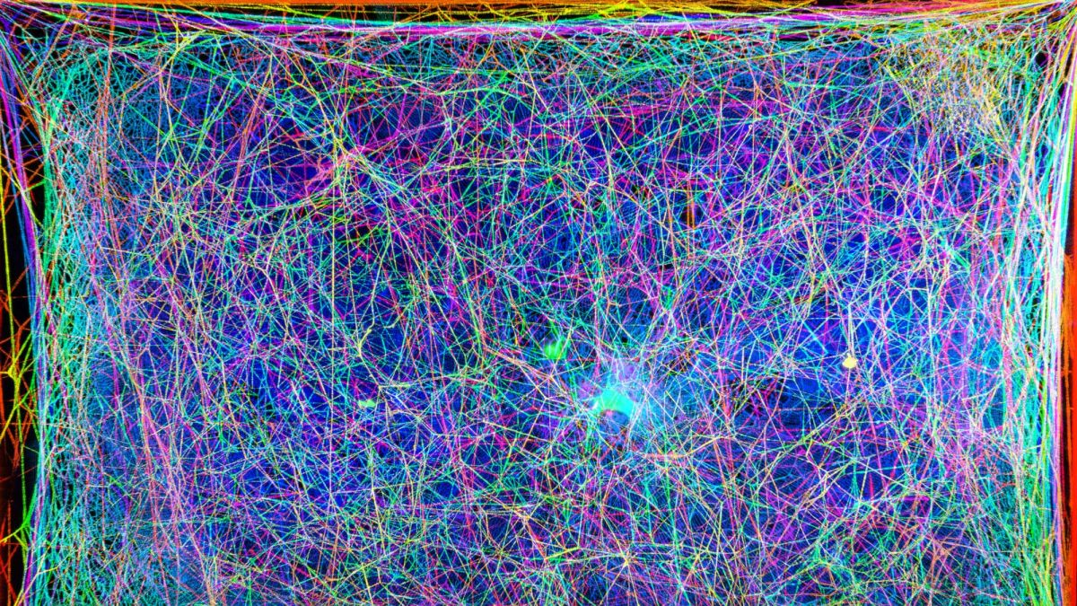




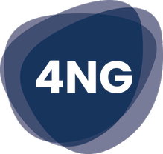
































Slide 8
and you are invited to come do an internship and explore job opportunities with us!

Slide 9

Moving On. Our Main Story today (and next week)
Applications
more specifically: Microservices – the best form of applications we have come up with so far
How they are designed
How they interact
How they can be implemented
Using:
Dapr.io – distributed application runtime
Node – popular, full stack, omnipresent programming language
Apache Kafka – distributed message broker, enterprise backbone

Slide 10
Overview
Part One (today)
Microservices recap
Dapr.io – personal assistant for applications & distributed application runtime
Handson with Dapr.io
Quick Intro to programming in Node[.js]
Handson Microservice implementation with Node and Dapr.io
Part Two (next week, 30 March)
Asynchronous interactions through Apache Kafka
Handson with Apache Kafka and Node
Real world use cases and scenarios with Apache Kafka
Handson Multi-microservice set up with Apache Kafka, Node and Dapr.io

Slide 11
Assumed is
A development environment with VS Code, Docker and the ability to install
Knowledge of
HTTP, REST, JSON
Containers, Docker (and Kubernetes)
Java or C#
SQL and a database (MySQL or PostgreSQL or SQL Server)
perhaps Message Broker/Event Queue (RabbitMQ?), Cache (Redis?)
Cloud fundamentals
Microservices concepts

Slide 12
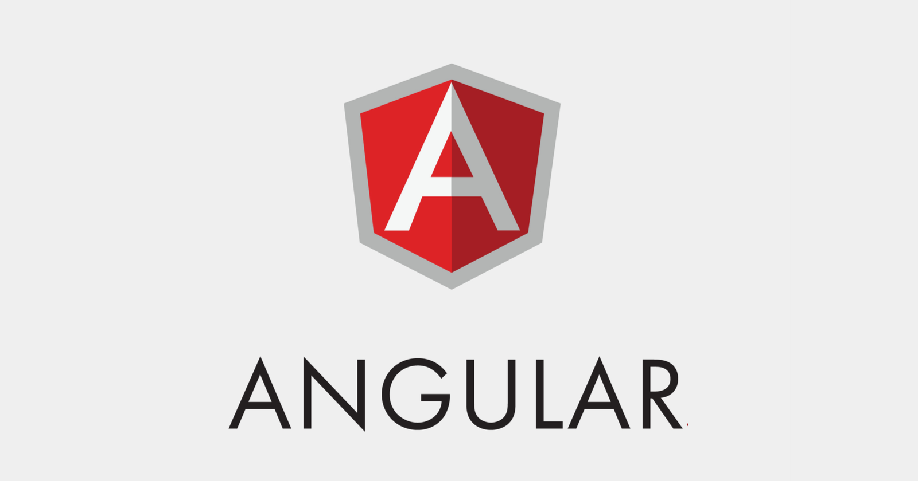





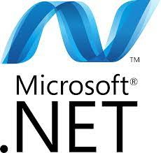




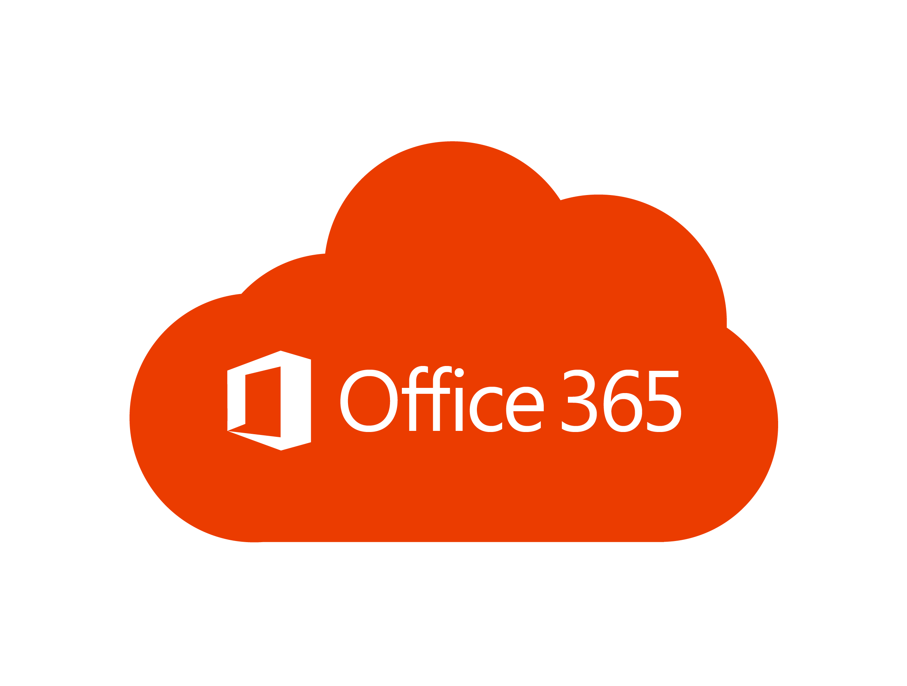
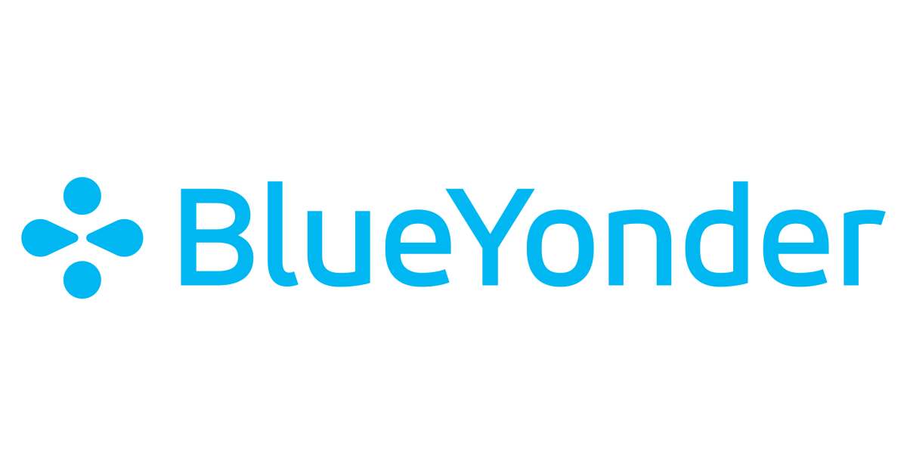

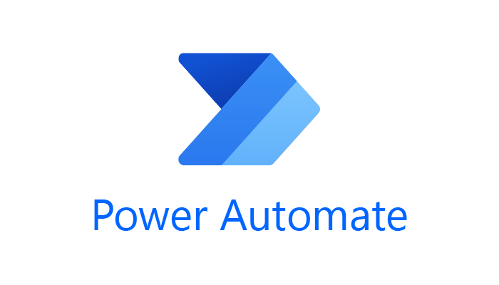
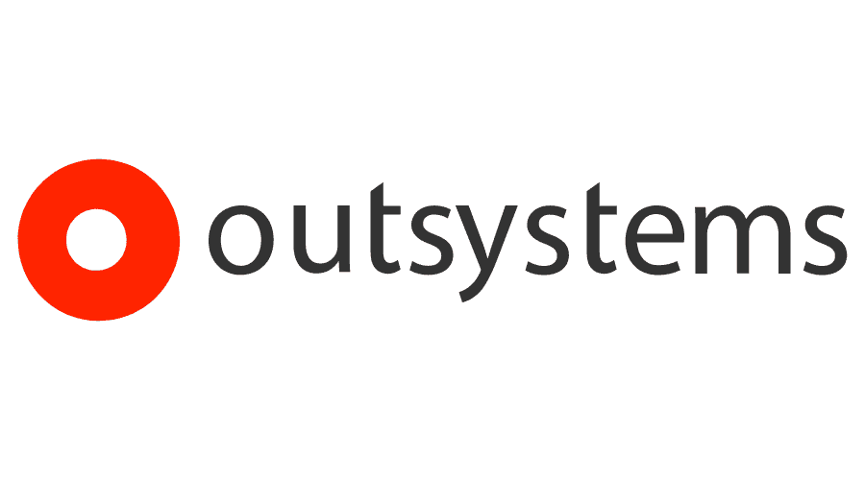
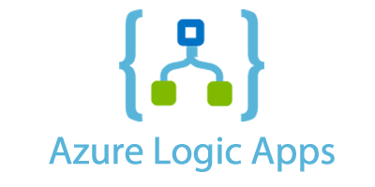

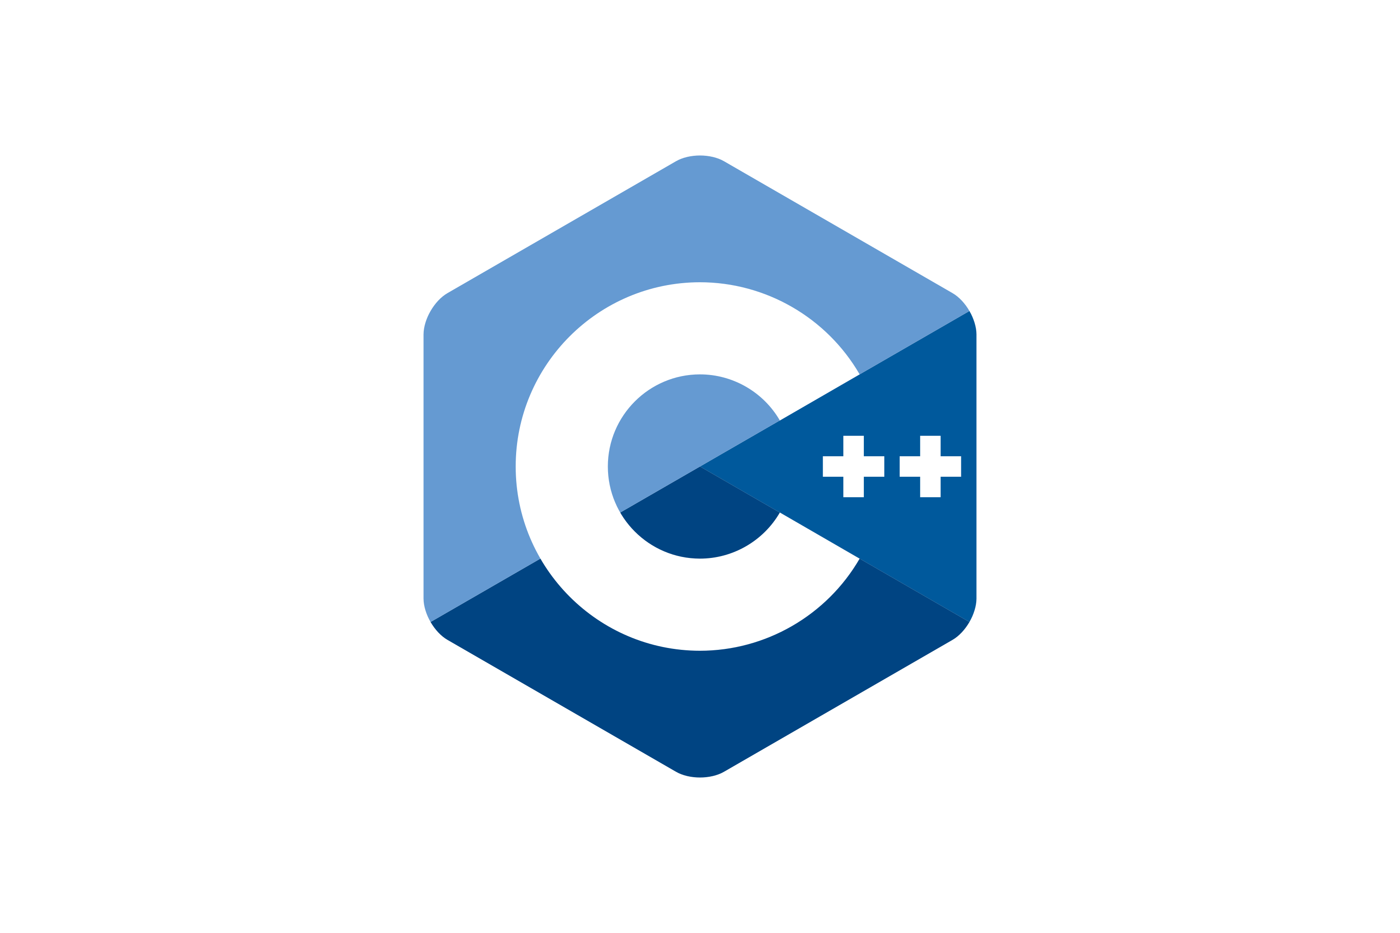
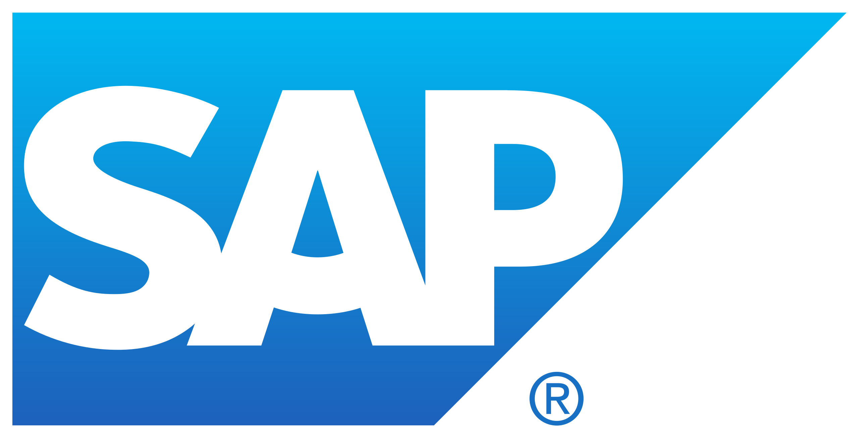










What is an Application?
Collection of (business) functionality
implemented with COTS, code, platform & infra
high code technology for bit & pixel perfect software with tailored fit (functionally & non-functionally)
best of breed applications per functional domain. (custom integration)
low code tools for workflow, automation, integration en frontends
(pre-)integrated application platform, to be custom configured
use as is out of the box
standard
custom
Database
IAM/ LDAP
Event / Message Broker
Web Server
API Gateway
Custom platform
Language Runtime
Operating System
Compute (Containers, VMs, bare metal servers)
Storage
Network
Custom hardware
Data Center
Power
Cooling

Slide 13
What is a microservice?
Why is a microservice?
Problems with (BIG) applications
complex
inflexible to change (when roll out changes)
long test, long build
impossible to upgrade technology (everything is affected)
hard to scale
hard to migrate (to different technology)
hard to learn (for new staff)

Slide 14

Final Demo
Microservices
Microservice

Slide 15
What is a microservice?
Not TOO big (but not too small either)
understandable by normal human beings – easy to on board new team members
easy to change – allow for agile functional and non functional evolution
functionally cohesive/logical collection of features => domain
design time decoupled, clear standards based external interfaces: API & events
low external impact of: change, refactor, move, migrate, scale, failure
reliable, robust, resilient
clear ownership (business sponsor; one IT team builds it, runs it, evolves it)
contains everything needed to run [on a generic platform]
application software, libraries/frameworks, platform configuration
pipelines for CI and CD, tests, documentation, infra as code

Slide 16
What is IT all about?
Production Runtime
Application

Slide 17
What is IT all about?
Production Runtime
Application
Business value
Platform

Slide 18
What is IT all about?
Production Runtime
Operations
Monitoring & Management
Application
Platform
Platform
Platform

Slide 19
Production Runtime is the Result of Preparation Runtime
Preparation Runtime
Production Runtime
Development
Operations
Monitoring & Management
Application
Application
Agile Design, Build, Test
Platform
Platform
CD

Slide 20
One team has Agile responsibility through full lifecyle
Preparation Runtime
Production Runtime
Development
Operations
Monitoring & Management
Application
Application
Agile Design, Build, Test
Platform
Platform
CD

Slide 21
One team has Agile responsibility through full lifecyle
Preparation Runtime
Production Runtime
DevOps
Development
Operations
Monitoring & Management
Application
Application
Agile Design, Build, Test
Platform
Platform
CD
You build it, you run it, you fix it, you evolve

Slide 22
One team has Agile responsibility through full lifecyle
DevOps
Application
Application
Platform
Platform
You build it, you run it, you fix it, you evolve

Slide 23
A microservice is owned by one team through its full lifecyle
DevOps
Microservice
You build it, you run it, you fix it, you evolve

Slide 24
The Microservice
HTTP REST/JSON
API
µ

Slide 25
Extended API of microservice
API
Deployment Interface
Injectable dependencies – reference to cache, logging, storage URL, …
Configurable meta-data – run time parameters, log level, credential (key)
Runtime Interaction Interface
REST API Resources & Operations – query and URL parameters, message formats
Events Consumed – alternative way to call | activate a microservice
Reference to entry in Event Catalog
May include reference to shared Cache Resource
Events Produced – alternative output from microservice
Event can be an asynchronous response to a stateless consumer

Slide 26
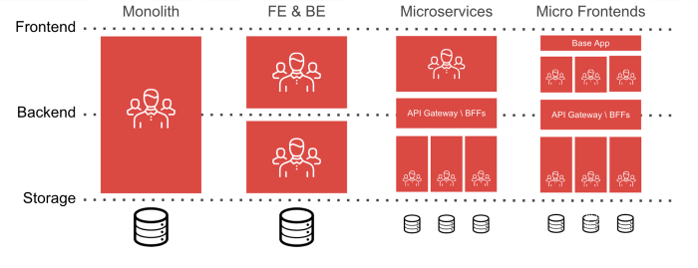
Independent microservices and an integrated front end

Slide 27
Independent microservices and an integrated front end
microservice / team

Slide 28
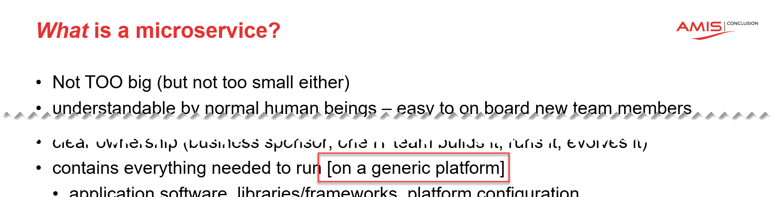
The Microservices Platform
API
API
API
API
µ
µ
µ
µ
Runtime Platform

Slide 29

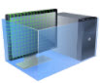

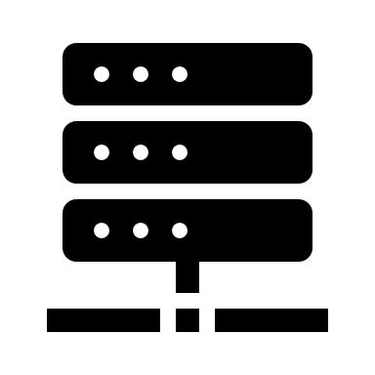

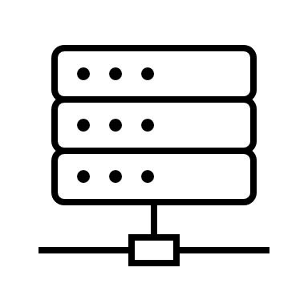
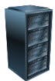
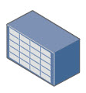
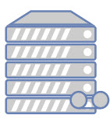

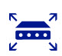
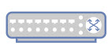








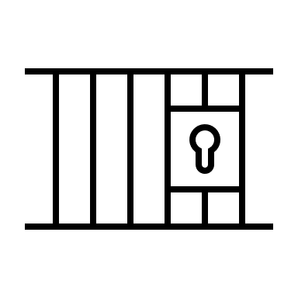
The Microservices Platform
Web Application Firewall
CDN
Load Balancer
API Gateway
API
µ
Job Scheduling
Container Registry
Build & Deploy Pipelines
Container engine
Serverless Functions
Artifact Repository
Code Repository
Virtual Machines
Logging
Monitoring
Auditing
IAM
Vulnerability Scanning
Resource Manager
Cloud Usage Analysis
Cloud Events
APIs
Certificate Management
Notifications
Cloud Guard
Tagging
Search
rack space
power
cooling
physical real estate

Slide 30
The Microservices Platform
Web Application Firewall
CDN
Load Balancer
API Gateway
API
µ
Message/ Event Broker
Job Scheduling
Container Registry
Data Cache
Build & Deploy Pipelines
SQL Database
Data Lake
Serverless Functions
Container engine
NoSQL Database
Artifact Repository
Code Repository
Virtual Machines
Vault
File Storage
Logging
Monitoring
Auditing
IAM
Vulnerability Scanning
Resource Manager
Cloud Usage Analysis
Cloud Events
APIs
Certificate Management
Notifications
Cloud Guard
Tagging
Search
rack space
power
cooling
physical real estate

Slide 31







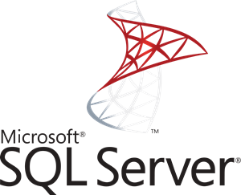

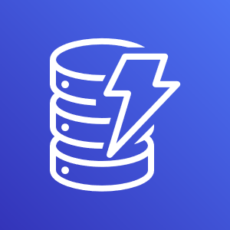
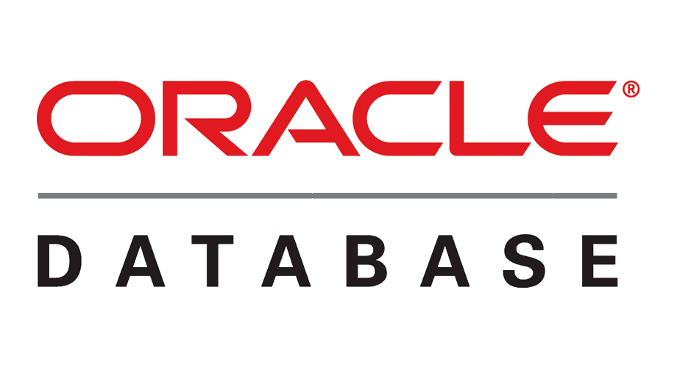
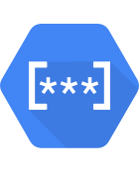
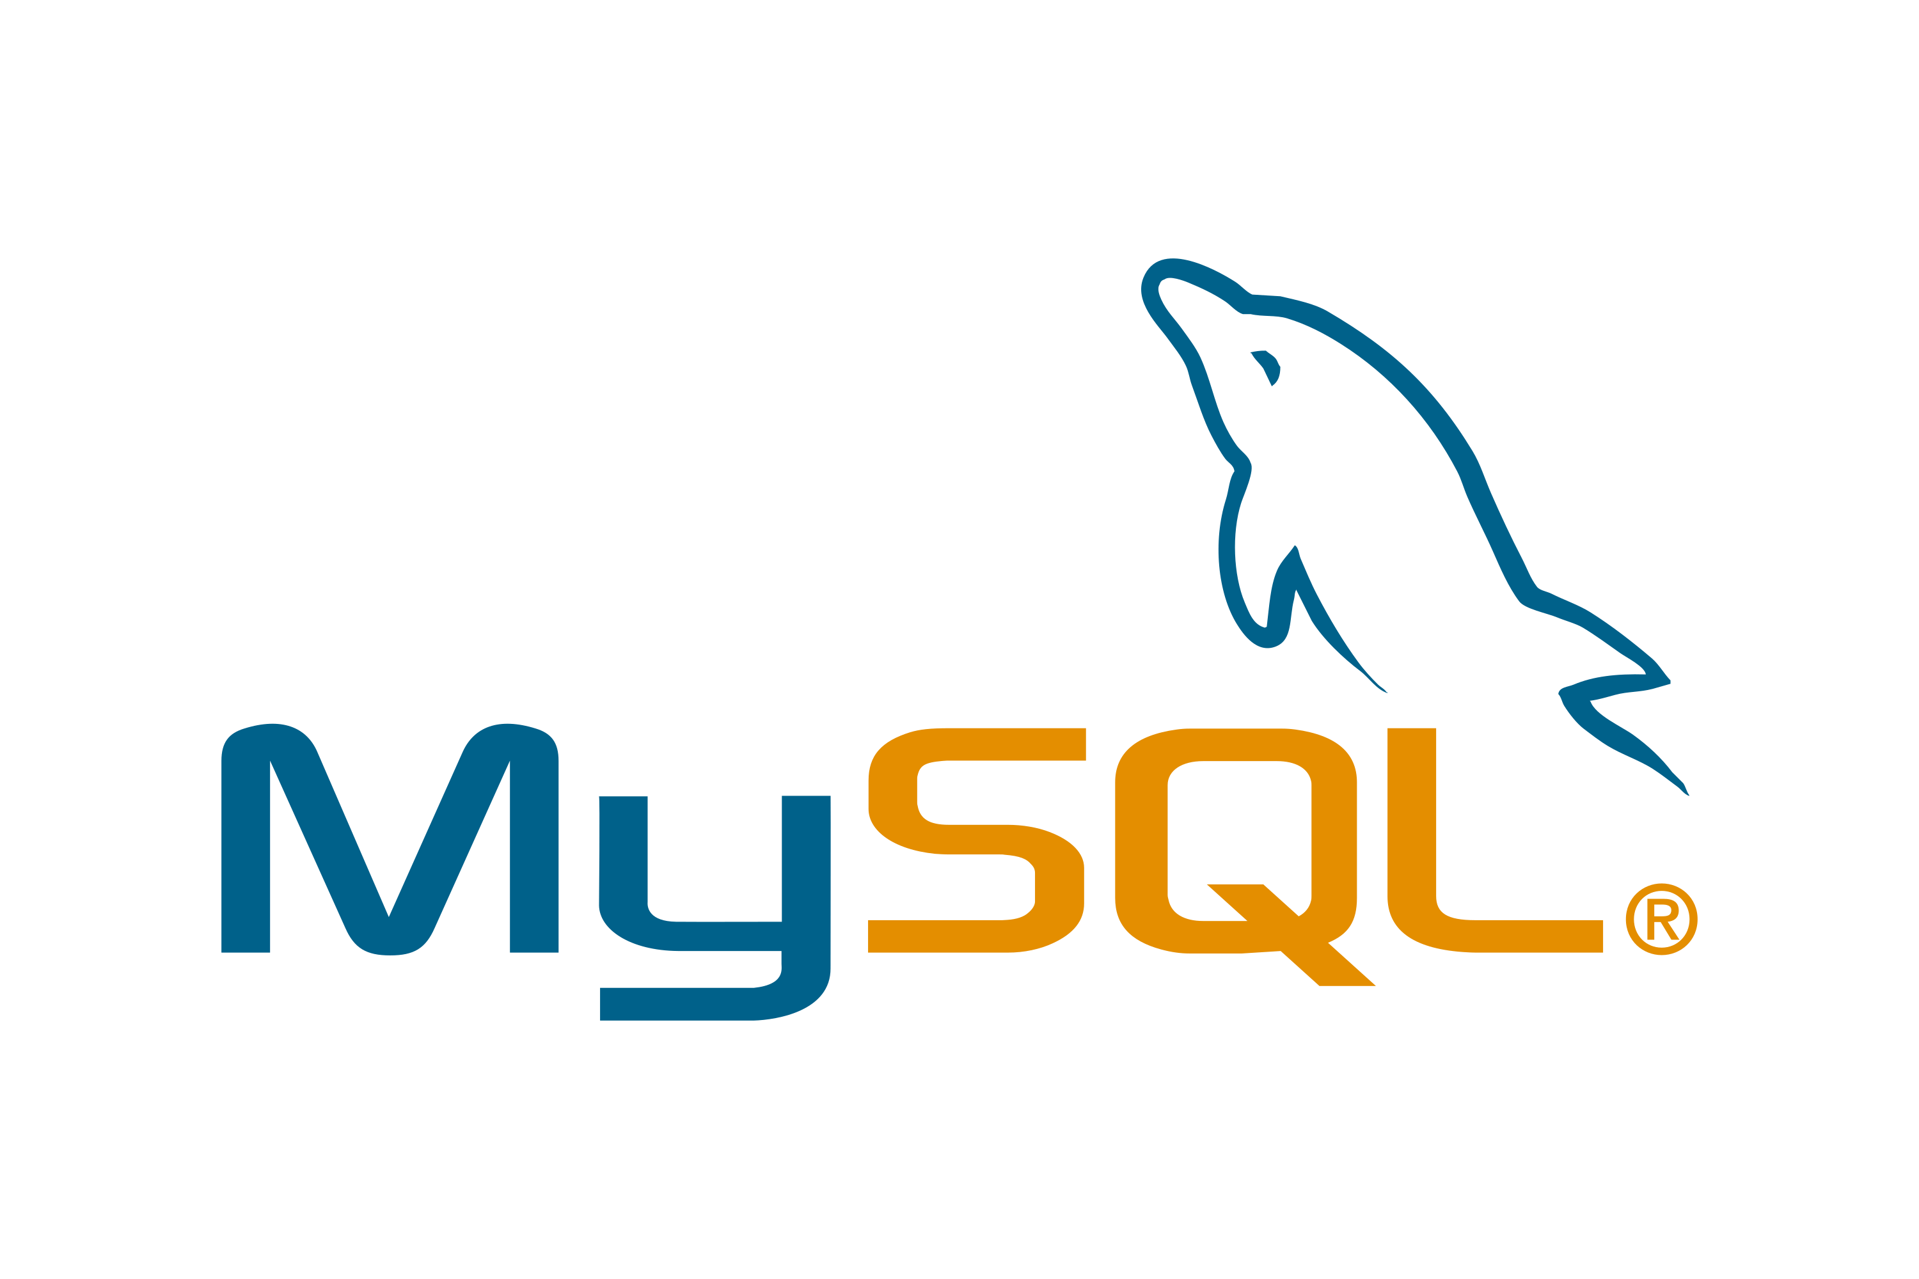

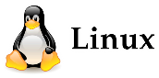













The Microservices Platform
Web Application Firewall
CDN
Load Balancer
API Gateway
API
AWS
SQS
GCP
Pub/Sub
Redis
µ
Message/ Event Broker
Kafka
Job Scheduling
Azure
Service Bus
Container Registry
Data Cache
RabbitMQ
Build & Deploy Pipelines
Redis
SQL Database
Data Lake
Cassandra
Serverless Functions
Container engine
NoSQL Database
Artifact Repository
Code Repository
Firebase
Virtual Machines
AWS
DynamoDB
Vault
Azure
CosmosDB
GCP
Secret Manager
File Storage
AWS
Secrets Manager
Logging
GCP
Storage
Monitoring
Auditing
AWS
S3
Azure
Storage
Azure
KeyVault
Resource Manager
Zipin
IAM
Vulnerability Scanning
HashiCorp
Vault
Cloud Events
APIs
Cloud Usage Analysis
Certificate Management
Notifications
Cloud Guard
Tagging
Search
rack space
power
cooling
physical real estate

Slide 32
What do most microservices do?
Store and retrieve state
Read runtime secrets and configuration values
Publish “observability data”
Subscribe to event topic and handle incoming events
Publish events to event topic
Interact with other microservices
Invoke external services
Run microservice specific business logic
This requires quite a bit of repetitive “plumbing” tied to specific technologies – not meaningful effort [from a business functionality perspective]

Slide 33
Dapr Distributed Application Runtime
quick introduction

Slide 34


Dapr
Runtime
Personal Assistant for Applications and Microservices
Distributed Application Runtime
Microservice architecture
Decoupling

Slide 35

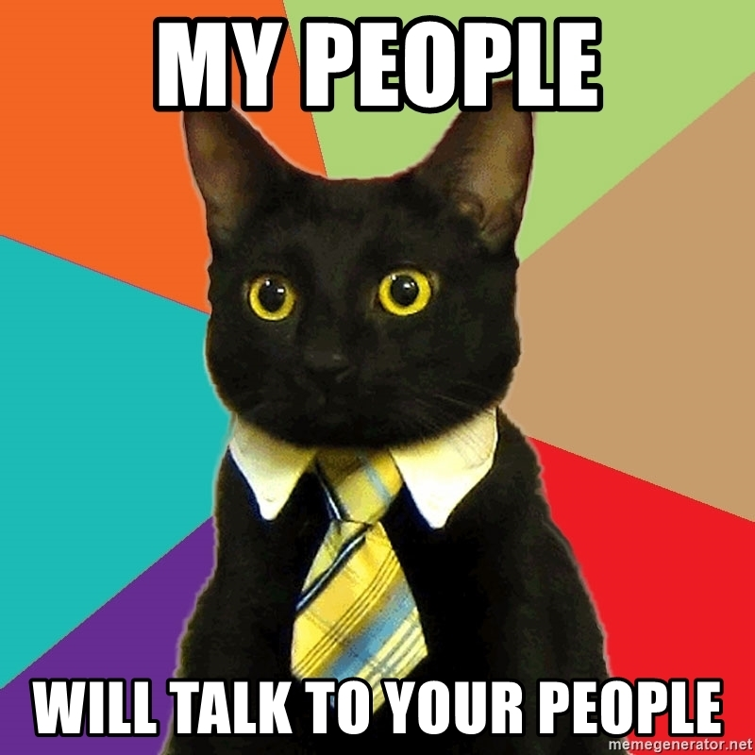

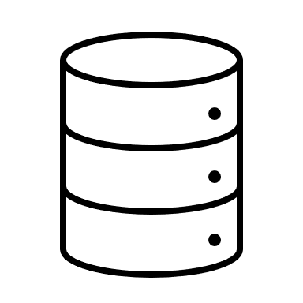

Dapr.io
Microservice or Monolith
Launched by Microsoft (2019)
Application runtime framework – supporting cloud native and serverless
Every application gets a uniform Personal Assistant that takes care of common tasks
remember (take note and reproduce)
keep log
restrict access
handle incoming
route outgoing
interact with other PAs (and their apps)
Personal Assistant (Dapr)
Application
Personal Assistant (Dapr)
Personal Assistant (Dapr)
Personal Assistant (Dapr)
Personal Assistant (Dapr)
Personal Assistant (Dapr)

Slide 36

Dapr.io
Personal Assistant is Dapr Side Car
companion process or side car container in Kubernetes Pod
Application
Dapr sidecar
Dapr API
My App
HTTP/gRPC

Slide 37



State management
Redis Cache
My App
key | value
myApp-weapon | "DeathStar"
POST
http://localhost:3500/v1.0/state/corpdb
[{
"key": "weapon",
"value": "DeathStar"
}]

Slide 38
State management
Redis Cache
Azure CosmosDB
My App
key | value
myApp-weapon | "DeathStar"
key | value
myApp-weapon | "DeathStar"
GET
http://localhost:3500/v1.0/state/corpdb/planet
"DeathStar"

Slide 39
State management
Azure CosmosDB
Redis Cache
My App
key | value
myApp-weapon | "DeathStar"
key | value
myApp-weapon | "DeathStar"
GET
http://localhost:3500/v1.0/state/corpdb/planet
"DeathStar"

Slide 40
Dapr state API
corpdb-redis.yaml
apiVersion: dapr.io/v1alpha1
kind: Component
metadata:
name: corpdb
spec:
type: state.redis
version: v1
metadata:
- name: redisHost
value: redis-master.default.svc.cluster.local:6379
- name: redisPassword
secretKeyRef:
name: redis-secret
key: redis-password
Save state
POST /v1.0/state/corpdb
Retrieve state
GET /v1.0/state/corpdb/mystate
Delete state
DELETE /v1.0/state/corpdb/mystate
Get bulk state
POST /v1.0/state/corpdb/bulk
Submit multiple state transactions
POST /v1.0/state/corpdb/transaction

Slide 41
Dapr state API
corpdb-cosmosdb.yaml
apiVersion: dapr.io/v1alpha1
kind: Component
metadata:
name: corpdb
spec:
type: state.azure.cosmosdb
version: v1
metadata:
- name: url
value: corpdb.documents.azure.com
- name: masterKey
secretKeyRef:
name: master-key
key: cosmos-key
- name: database
value: orders
- name: collection
value: processed
Save state
POST /v1.0/state/corpdb
Retrieve state
GET /v1.0/state/corpdb/mystate
Delete state
DELETE /v1.0/state/corpdb/mystate
Get bulk state
POST /v1.0/state/corpdb/bulk
Submit multiple state transactions
POST /v1.0/state/corpdb/transaction

Slide 42

Microservice building blocks
HTTP API
gRPC API
Service-to-service invocation
State management
Publish and subscribe
Resource bindings and triggers
Actors
Observability
Secrets
Extensible

Slide 43

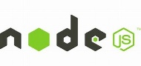



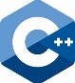

Any language and framework
Standard APIs accessed over http/gRPC protocols from user service code
Runs as local “side car library” dynamically loaded at runtime for each service
Application code
Microservices written in
Any code or framework…
HTTP API
gRPC API
Service-to-service invocation
State management
Publish and subscribe
Resource bindings and triggers
Actors
Observability
Secrets
Extensible

Slide 44
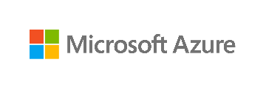



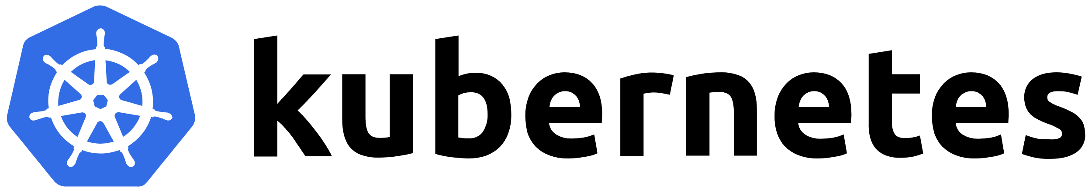


Any cloud or edge infrastructure
Application code
Microservices written in
Any code or framework…
HTTP API
gRPC API
Service-to-service invocation
State management
Publish and subscribe
Resource bindings and triggers
Actors
Observability
Secrets
Extensible
Hosting infrastructure
Azure Arc
On-Premises

Slide 45
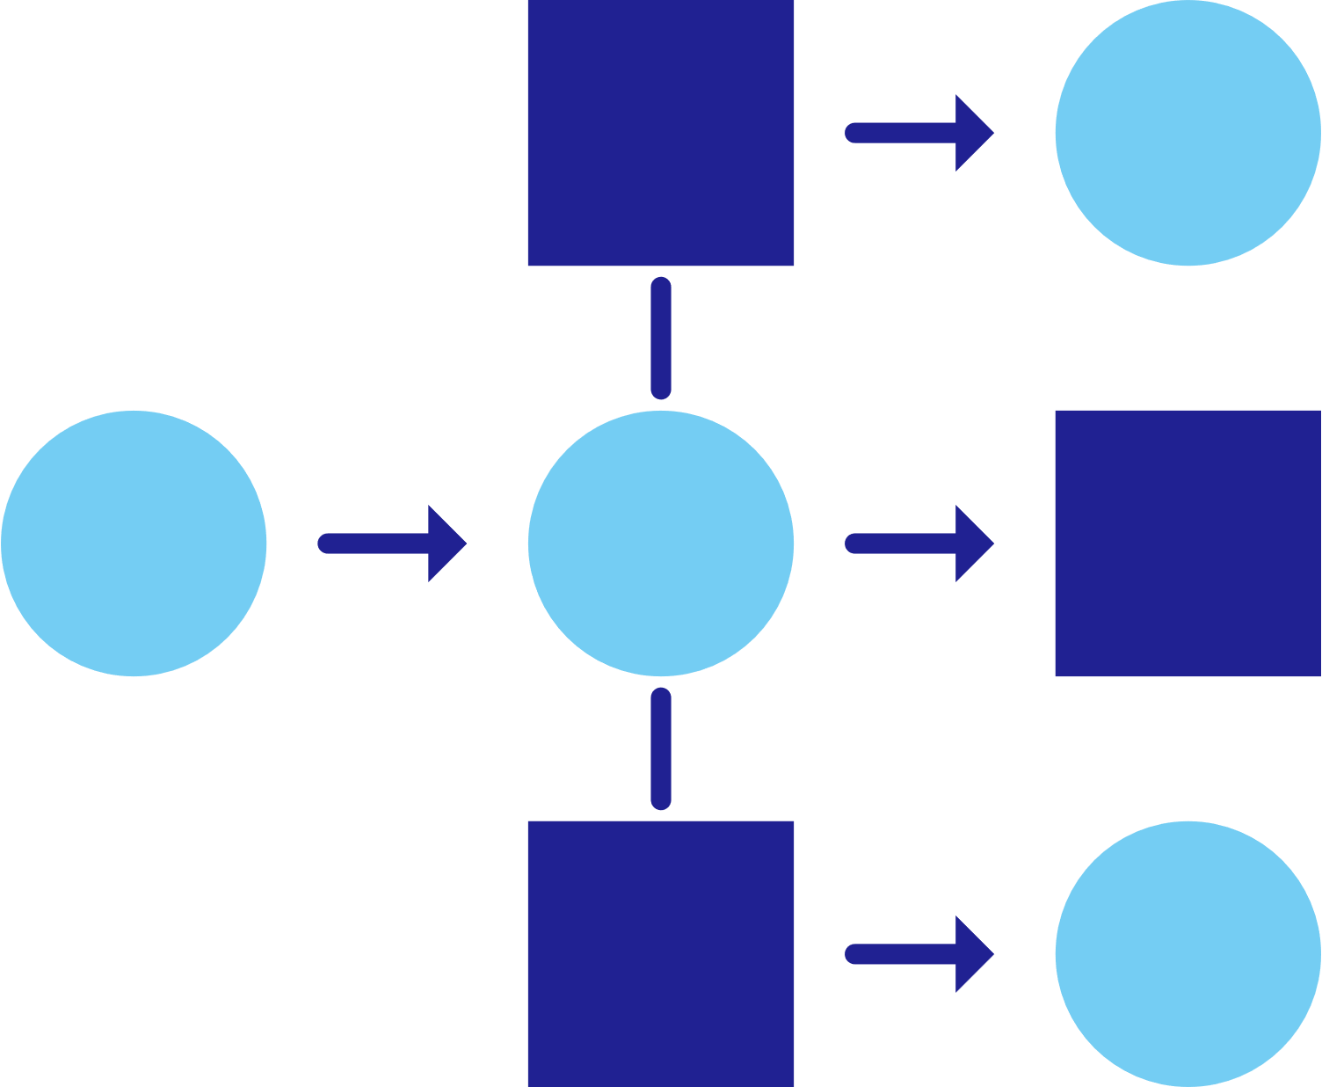



Service invocation
mDNS
Multicast DNS component for service discovery
My App
Service A
mTLS encryption
POST
http://localhost:3500/v1.0/invoke/servicea/method/neworder
POST
http://10.0.0.2:8000/neworder
{"data":"Hello World"}
{"data":"Hello World"}

Slide 46
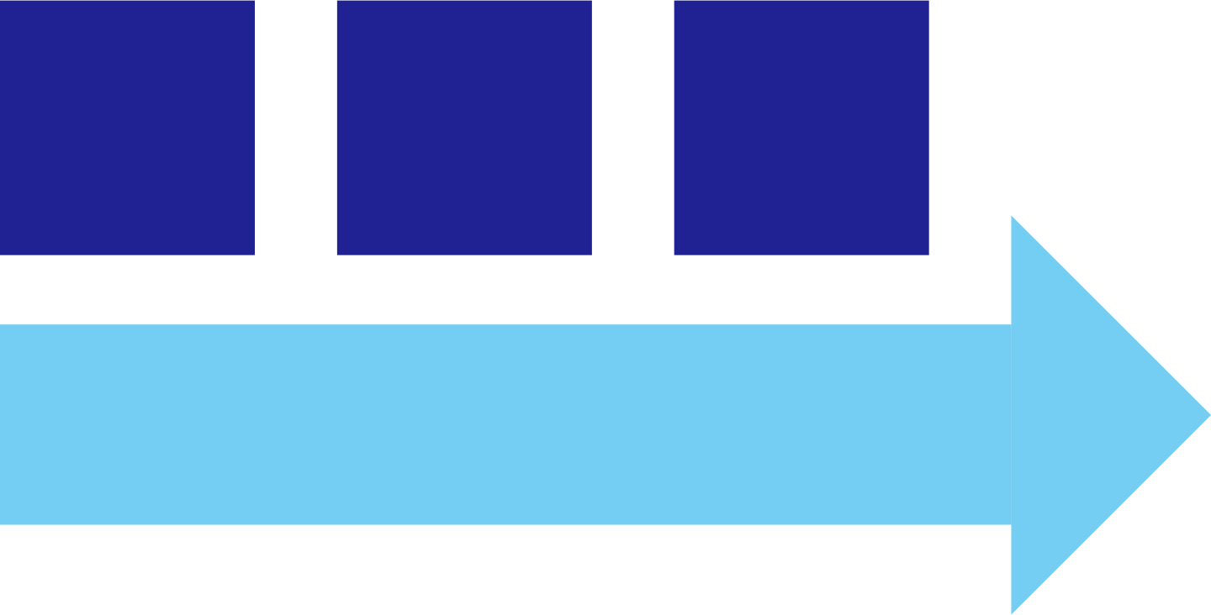
Publish and subscribe
Service A
My App
Redis
Cache
Service B
POST
http://localhost:3500/v1.0/publish/orders/processed
POST
http://10.0.0.2:8000/orders
http://10.0.0.4:8000/factory/orders
{"data":"Hello World"}
{"data":"Hello World"}

Slide 47


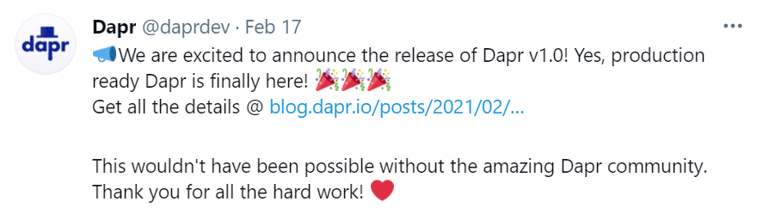
Input triggers
Twitter
My App
POST
http://10.0.0.2:8000/newtweet
{"data":“📢 We are excited to announce the …"}

Slide 48

Output bindings
My App
Twilio
POST
http://localhost:3500/v1.0/bindings/twilio
Hello World
{"data":"Hello World"}

Slide 49


Secrets
My App
HashiCorp Vault
key | value
mysecret | "supersecret"
GET
http://localhost:3500/v1.0/secrets/vault/mysecret
"supersecret"

Slide 50

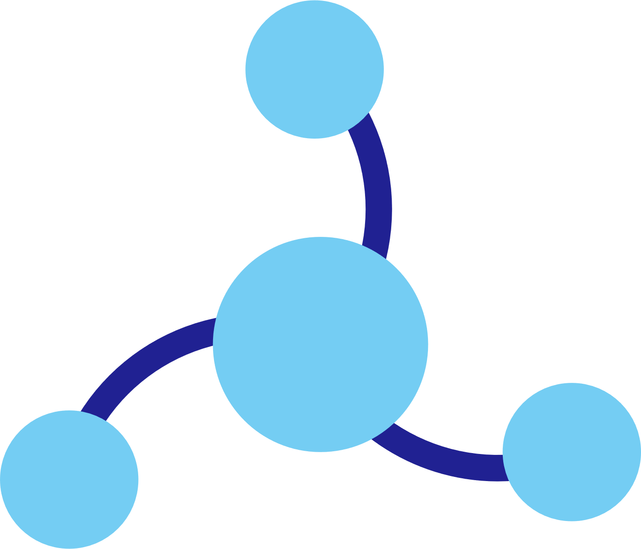
Observability
Service A
Twitter
My App
Redis
Cache
Service B
OpenTelemetry collector
Logging &
tracing extensions

Slide 51
Dapr hosting environments
Get started with dapr init
Easy setup with Docker images
Sets up placement, Zipkin, Redis
slim-init available without Docker
Run any application with Dapr sidecar using dapr run
Get started with dapr init -k
Fully managed Dapr control plane
Deploys dashboard, placement, operator, sentry, and injector pods
Automatically inject Dapr sidecar into all annotated pods
Upgrade with dapr upgrade or Helm
Self-hosted

Slide 52



Dapr in self-hosted Docker mode
Dapr Components
dapr run myapp
State Stores
Launch application
Launch sidecar process
Set env variables
PubSub
Brokers
My App
Use components
Bindings
& Triggers
Zipkin
tracing
Zipkin
Send distributed tracing
Secret Stores
Redis
state store
Redis
Save and retrieve state
Publish and subscribe to messages
Local dev machine or virtual machine
Observability

Slide 53
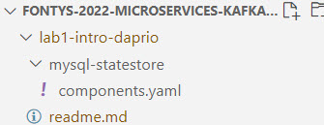
Hands On Lab 1
In a Linux compatible environment with Docker CLI set up
Download and Install Dapr.io
with out of the box state management and pub/sub based on Redis and telemetry observation by Zipkin
Run Dapr Sidecar
Explore Dapr State Management APIs
from the command line (cURL HTTP calls)
Run MySQL container and have Dapr manage state in a MySQL database
Explore Dapr Telemetry collection and presentation in Zipkin
labs: https://github.com/lucasjellema/fontys-2022-microservices-kafka-dapr
Notes:
https://github.com/lucasjellema/fontys-2022-microservices-kafka-dapr

Slide 54
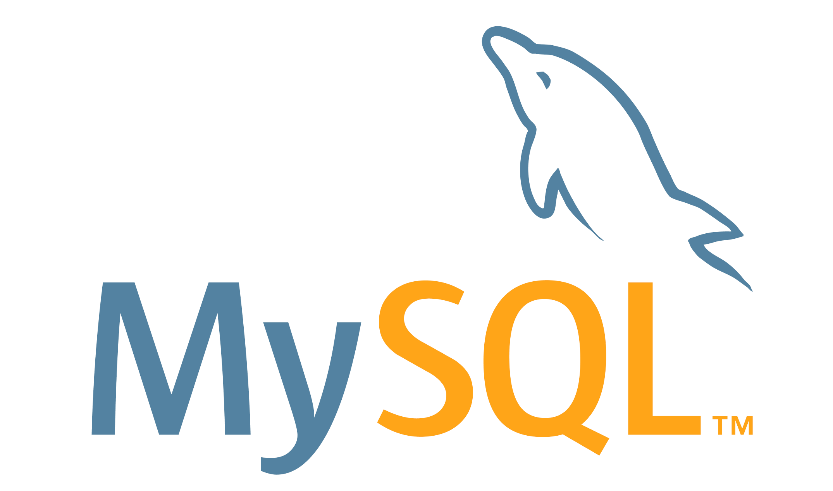
Dapr in self-hosted Docker mode – add MySQL Database
daprdapr run --app-id myotherapp --dapr-http-port 3510 --components-path .
Launch application
Launch sidecar process
Set env variables
MySQL
database
Save and retrieve state
myotherapp
Zipkin
tracing
Zipkin
Redis
state store
mysql-statestore.yaml
Redis
Local dev machine or virtual machine

Slide 55
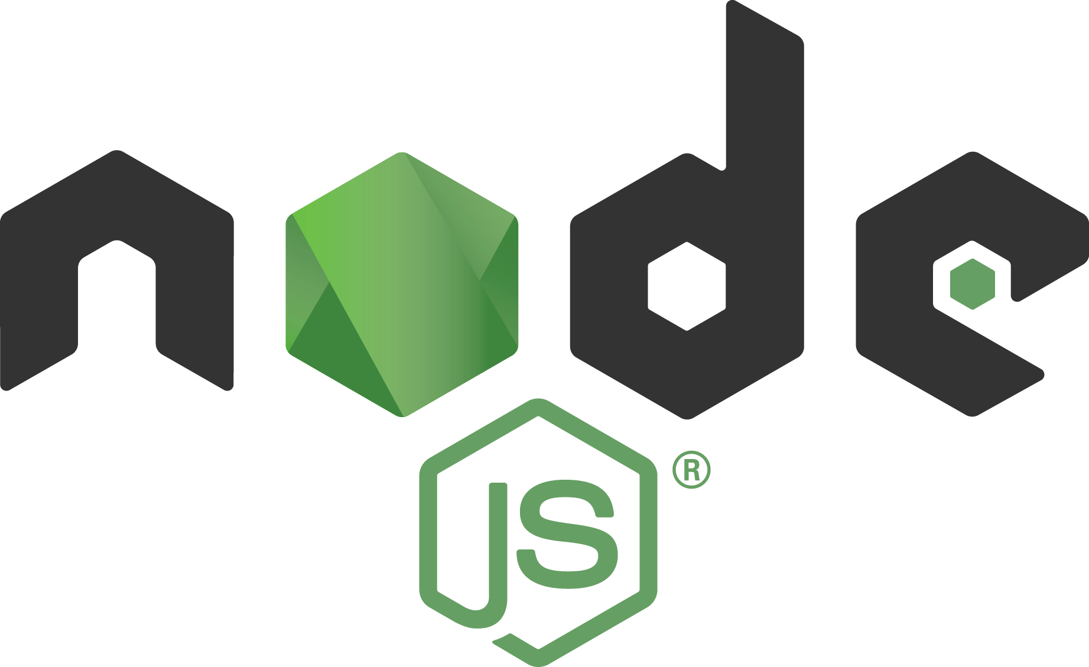
Introduction Node

Slide 56
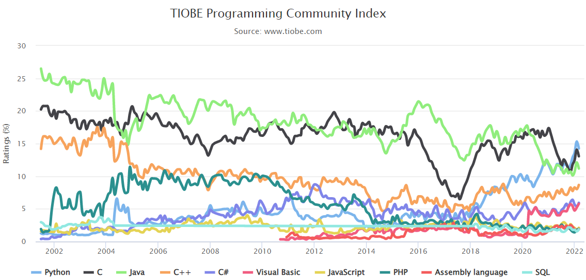
General Purpose Programming Languages
C & C++
COBOL, Fortran, ALGOL, BASIC, Pascal
SmallTalk
Visual Basic
Python
PHP, Perl, Ruby
Java
JavaScript (ECMAScript, ES)
C#
Go
Kotlin
Rust
Notes:
Implementatie van microservices: afhandelen van http requests, consumeren en publiceren van events, doen van http calls: wat zijn activiteiten die iedere microservice moet uitvoeren? (state mgt, pub/sub, secrets, config mgt, aanroepen 3rd party (cloud) services, ..)
Introductie en demo van Dapr.io framework – de personal assistant die iedere applicatie eenvoudig laat aansluiten op generieke voorzieningen én die applicaties (microservices) met elkaar laat interacteren op ontkoppelde wijze; note: ik zal wijzen op de ondersteuning in Dapr.io voor diverse technologieën zoals RabbitMQ, MySQL, Redis
Handson met Dapr – meegeleverde applicaties in Java en C#
Zelf implementeren van microservice – introductie van NodeJS ;
Handson: afbouwen eenvoudige services in NodeJs en via Dapr.io interactie met elkaar en met generieke voorzieningen
College 2 – Kafka als backbone van microservice gebaseerde applicaties, containers & Kubernetes als deployment vehikel en runtime platform
Korte recap – microservices, API & Events, Dapr.io , Kafka;
Intro & Demo van Kafka en plek van Kafka in microservices architecture (en gebruik van Kafka bij grote organisaties)
Handson: interactie met Kafka vanuit eenvoudige NodeJS applicatie
Handson: interactie tussen NodeJS applicaties via Kafka
Kafka via Dapr.io
Handson: microservice pub/sub interactie via Dapr.io sidecar en Kafka; wissel Kafka en Redis base pub/sub (dit kan met NodeJS maar ook met Java of C#)
Handson: microservice binding interactie via Dapr.io sidecar met externe Kafka broker ; studenten kunnen events met elkaars microservices uitwisselen
Intro Kafka Connectors
HerIntro Containers & Kubernetes
Microservices met Containers op Kubernetes plus plek van Dapr.io
Handson:
lokaal draaien van Kubernetes (met minikube of k3s),
Dapr.io op lokaal cluster
Bouw microservice tot Dapr-enabled container en deploy op lokaal cluster; test microservice
Voeg tweede microservice toe die met de eerste interactie heeft
Bonus: horizontaal schalen van eerste service – load balancing door Dapr in aanroepen naar de twee of meer instanties van de eerste service

Slide 57
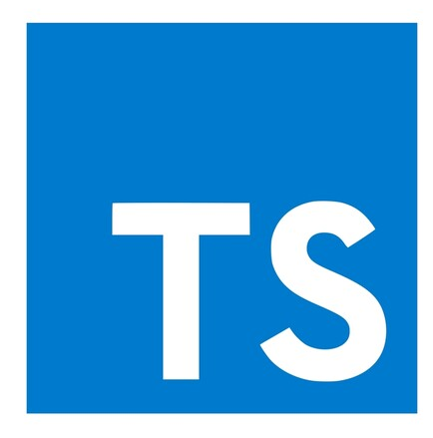
Node == Server Side JavaScript
Script: Not statically typed, not compiled – interpreted at runtime
Node(JS) – open source, runtime based on Chrome V8 JavaScript engine
initial release: 2009
Full stack development – server side and client side can leverage JavaScript
for example: MEAN stack (MongoDB, Express, Angular, NodeJS)
Light weight, quick startup, support for high concurrency
Skills widely available, many resources, tools and libraries
Easy to get started, quite high productivity and fun factor
Functions are primary citizens – functional programming well supported
Quite suitable for microservices – including containerized and serverless
Available everywhere – cross platform, all public clouds
Note: TypeScript compiles to Node that is interpreted at runtime

Slide 58
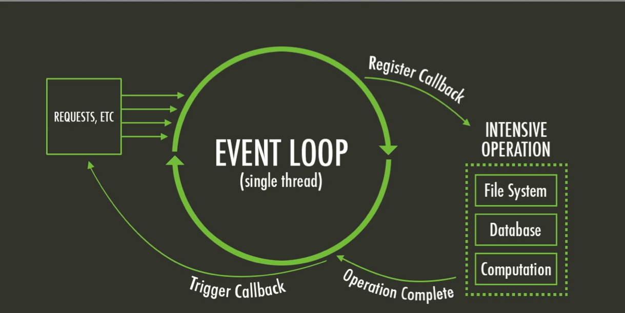
Introducing Node – Single Thread model
Multi-thread languages – such as Java – typically block when file system or network operations take place
Parallel processing continues in parallel threads
Threads consume resources and are only somewhat scalable
JavaScript has a main (single thread) event loop and uses asynchronous processing
Non-blocking handling of file system interactions, HTTP calls, network operations and other blocking actions
Scalable, very quick startup

Slide 59
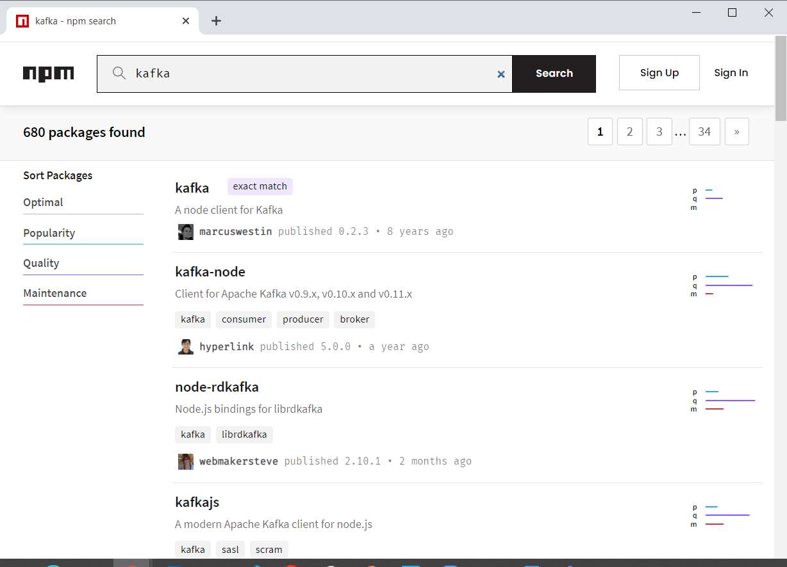
Introducing Node - NPM
NPM = Node Package Manager
To include libraries from the ecosystem
Leverages npm registry (> 1.3M NPM Modules available)
Acquired by Microsoft – March 2020
To build and run Node applications
similar to Maven & Gradle (Java) or pip (Python)
Yarn and Turbo are popular alternatives
Notes:
http://www.modulecounts.com/

Slide 60
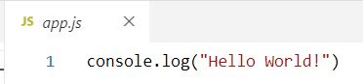
Hello World in Node
app.js
with the code to execute
(optional) package.json
with NPM dependencies, build and run configuration (compare Maven pom.xml)
Create Node application:
npm init (optional, you can just create a text file by hand instead)
Run Node application
node app.js
npm start
Add dependencies
npm install <name of module> --save

Slide 61

Functions
Functions
have a name
take zero, one or multiple untyped input parameters
return zero or one untyped result
or an exception instead of a result

Slide 62


Functions
Function references
can be assigned to a variable
can be passed around
can be invoked
Note: function name without parentheses is not a call to the function but a reference
print vs print()

Slide 63

Functions
Function references can be closures – function + state
closures contain values of local context at the time of instantiation
closure
Hello
1
World
2

Slide 64

Require – to import a module
Node contains many out of the box modules
for example: file, os, http, stream, crypto, net, url
The NPM package manager adds more than 1M modules to make us of
You can create your own (reusable) modules
To access elements from a module, that module needs to be identified, using: const <logical name> = require('module name')
Module name can be reference to a local file, to a global module or to the name of a module defined in package.json (and installed in the application’s node-modules directory)

Slide 65


Node – Asynchronous calls
JavaScript is single threaded – no parallel threads can be started from your code
Any action in Node that requires network or file system interaction is typically performed asynchronously:
the command is started and handed to the Node background processes; the main thread continues with other work
when the background processes have completed the task, the results are returned to the invoker (when the main thread has an opening)

Slide 66


Node – Asynchronous HTTP calls
Many modules are available for HTTP communications from Node
The standard HTTP module is not the most convenient
An HTTP request is processed asynchronously in all cases
main program loop proceeds while request is made
response
asynchronous HTTP request

Slide 67


Asynchronous – waiting for one or more asynchronous results
A function is declared to be asynchronous using the async keyword
The result of an asynchronous function is an object of type Promise
in order to get the actual value – the Promise must be “resolved”
this can be waited for using the keyword await
Alternatively – especially when multiple asynchronous results are waited for at the same time – we can use Promise.then( <callback function>) or Promise.all( <callback function>) to wait for Promise results to come available

Slide 68

Hello World Web Application
Node is very good at handling HTTP Requests
It is a great technology to implement REST APIs and backends for Web and Mobile applications
fast, scalable, easy to develop and to deploy
define the function that handles each HTTP request and prepares the response

Slide 69





Dapr and Node Applications
State
Stores
AWS
DynamoDB
Azure
CosmosDB
Firebase
Redis
Cassandra
PubSub
Brokers
AWS
SQS
Azure
Service Bus
GCP
Pub/Sub
Redis
RabbitMQ
Bindings
& Triggers
AWS
S3
Azure
Storage
GCP
Storage
Twilio
Kafka
Secret
Stores
AWS
Secrets Manager
Azure
KeyVault
GCP
Secret Manager
HashiCorp
Vault
Kubernetes
Secret
HTTP (or gRPC) with Dapr SideCar
easier yet: Node SDK for Dapr
Leverage Dapr and its building blocks for
simple state management
simple publication of messages
subscription to incoming messages
retrieving secrets
retrieving configuration data
invoking external services (database, message broker, store, API)
register as listener to inbound requests and messages for external services
decoupled interaction between microservices – implemented in potentially very different languages
Observability
Prometheus
AppInsights
Zipkin
Jaeger
Node SDK for Dapr
components.yaml
sidecar (the personal assistant)

Slide 70

State Management with Dapr from Node application
State
Stores
AWS
DynamoDB
Azure
CosmosDB
Firebase
Redis
Cassandra
state store interface
State Store components
Node SDK for Dapr
set & get state
components.yaml
sidecar (the personal assistant)

Slide 71

State Management with Dapr from Node application
connect to sidecar
State
Stores
AWS
DynamoDB
Azure
CosmosDB
Firebase
Redis
Cassandra
state store interface
retrieve state
State Store components
Node SDK for Dapr
setstate
set & get state
components.yaml
sidecar (the personal assistant)

Slide 72
workaround: direct call to other app’s sidecar because call from side car to side car (may) fail in some environments
Default, out of the box
?name=Joseph
?name=John
dapr_host, dapr_http_port
http
http
app_port
components.yaml
app_port
app.js
app.js
Node SDK for Dapr
Node SDK for Dapr
get & set
name, instance count
State
Stores
key | value
John Monty | 3 2
AWS
DynamoDB

Slide 73
topic: orders
PubSub
Brokers
publish to topic orders on pubsub component
Redis
publish
publisher.js

Slide 74
topic: orders
PubSub
Brokers
Redis
consume
subscribe
consumer.js
subscribe to topic orders on pubsub component

Slide 75
topic: orders
PubSub
Brokers
publish to topic orders on pubsub component
Redis
consume
publish
publisher.js
subscribe
consumer.js
subscribe to topic orders on pubsub component

Slide 76

State Management with Dapr from Node application - switch to MySQL state store with configuration change
connect to sidecar
State
Stores
Azure
CosmosDB
Firebase
Redis
Cassandra
state store interface
retrieve state
State Store components
Node SDK for Dapr
setstate
set & get state
components.yaml
sidecar (the personal assistant)

Slide 77
State Management with Dapr from any application - either through SDK or using HTTP or gRPC
State
Stores
AWS
DynamoDB
Azure
CosmosDB
Firebase
Redis
Cassandra
MySQL
state store interface
SDK for Dapr
State Store components
set & get state
components.yaml
sidecar (the personal assistant)

Slide 78
Pub/Sub with Dapr from Node applications
PubSub
Brokers
AWS
SQS
Azure
Service Bus
GCP
Pub/Sub
Redis
RabbitMQ
pub/sub interface
Pub/Sub components
message sent to handler
Node SDK for Dapr
Node SDK for Dapr
publish message
subscribe on topic with handler function
components.yaml
sidecar (the personal assistant)
components.yaml

Slide 79


Pub/Sub with Dapr from Node applications
PubSub
Brokers
AWS
SQS
Azure
Service Bus
GCP
Pub/Sub
Redis
RabbitMQ
pub/sub interface
Pub/Sub
components
publish message
message sent to handler
Node SDK for Dapr
Node SDK for Dapr
publish message
subscribe on topic with handler function
components.yaml
sidecar (the personal assistant)
components.yaml

Slide 80

Pub/Sub with Dapr from Node applications
PubSub
Brokers
AWS
SQS
Azure
Service Bus
GCP
Pub/Sub
Redis
RabbitMQ
message sent to handler
pub/sub interface
subscribe on topic
Pub/Sub
components
Node SDK for Dapr
Node SDK for Dapr
publish message
components.yaml
sidecar (the personal assistant)
components.yaml

Slide 81
Asynchronous Interaction between Microservices
PubSub
Brokers
Redis
RabbitMQ
publish
consume
name = John
http
Front App
subscribe
Node App
get
get & set
State
Stores
AWS
DynamoDB

Slide 82
Asynchronous Interaction between Microservices
PubSub
Brokers
Redis
RabbitMQ
publish
name = John
http
Front App
get
State
Stores
AWS
DynamoDB

Slide 83
Asynchronous Interaction between Microservices shared (global) state
PubSub
Brokers
keyPrefix = none (global state)
pubsub.yaml
Redis
RabbitMQ
statestore.yaml
publish
consume
name = John
http
Front App
subscribe
Node App
pubsub.yaml
get
get & set
name, instance count
statestore.yaml
key | value
John Monty | 3 2
State
Stores
keyPrefix = none (global state)
AWS
DynamoDB

Slide 84


Telemetry Observation in Zipkin
Telemetry Data
PubSub
Brokers
Redis
RabbitMQ
publish
consume
name = John
http
greeter
subscribe
name-processor
get
get & set
State
Stores
AWS
DynamoDB

Slide 85


Telemetry Observation in Zipkin
Telemetry Data
PubSub
Brokers
Redis
RabbitMQ
publish
consume
name = John
http
Front App
Node App
subscribe
get
get & set
State
Stores
AWS
DynamoDB

Slide 86

Handson Lab 2
Install Node (and npm) runtime
Explore Node
hello world
functions
asynchronous
http server
Explore Node and Dapr
add state management to Node application – through Dapr sidecar
implement pub/sub for Node applications – through Dapr sidecar
realize asynchronous communication between Node based microservices through Daprized pub/sub
Explore Telemetry for asynchronous interactions
labs: https://github.com/lucasjellema/fontys-2022-microservices-kafka-dapr

Slide 87
Handson Lab 2
Default, out of the box
?name=John
dapr_host, dapr_http_port
http
components.yaml
app_port
app.js
Node SDK for Dapr
get & set
name, instance count
State
Stores
key | value
John Monty | 3 2
AWS
DynamoDB

Slide 88

Microservices in real life – with Node & Dapr.io & 30 March 2022
Next Week:
Apache Kafka
Lucas Jellema Architect & CTO AMIS | Conclusion
Notes:
Wat is een microservice? (waarom, problemen met monolitische applicaties, hoe microservice architectuur, generieke voorzieningen & platform voor microservices, data & events als glue tussen microservices)
Hier alvast stilstaan bij het belang van een event broker en een korte intro van Kafka (meer in college 2)
Implementatie van microservices: afhandelen van http requests, consumeren en publiceren van events, doen van http calls: wat zijn activiteiten die iedere microservice moet uitvoeren? (state mgt, pub/sub, secrets, config mgt, aanroepen 3rd party (cloud) services, ..)
Introductie en demo van Dapr.io framework – de personal assistant die iedere applicatie eenvoudig laat aansluiten op generieke voorzieningen én die applicaties (microservices) met elkaar laat interacteren op ontkoppelde wijze; note: ik zal wijzen op de ondersteuning in Dapr.io voor diverse technologieën zoals RabbitMQ, MySQL, Redis
Handson met Dapr – meegeleverde applicaties in Java en C#
Zelf implementeren van microservice – introductie van NodeJS ;
Handson: afbouwen eenvoudige services in NodeJs en via Dapr.io interactie met elkaar en met generieke voorzieningen

